Slide 1
Prediction of Albums on Billboard top 200
Ankit Prasad Prateik Mahendra

Slide 2
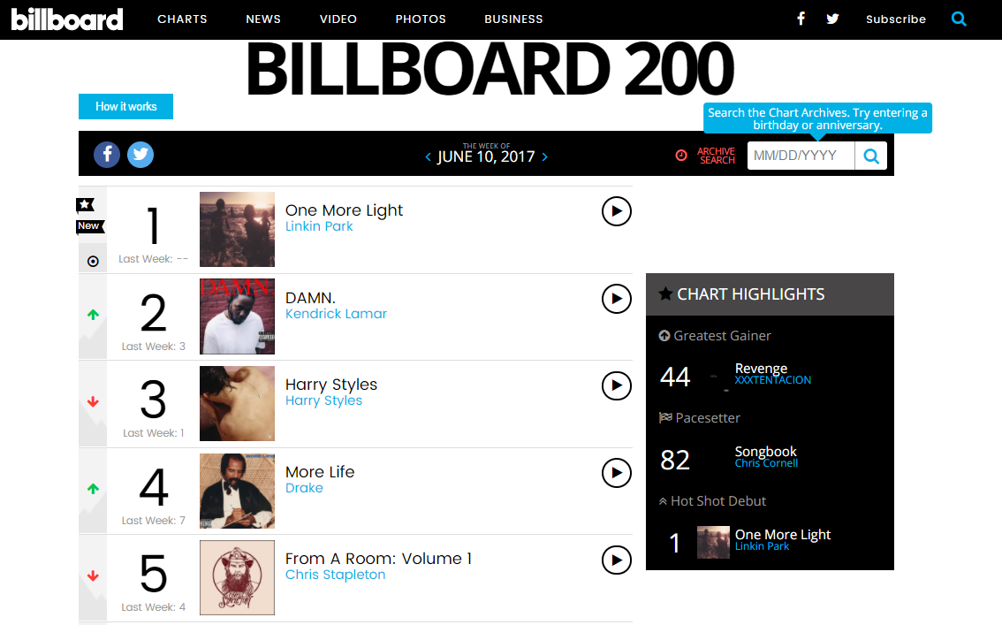


What is Billboard top 200?
It is a record chart ranking the 200 most popular music albums in the United States, published weekly by Billboard magazine. It is frequently used to convey the popularity of an artist or groups of artists.

Slide 3
Some facts
Majority do not make it to top 200 ever
Approx. 80000 albums released every year since 2006

Slide 4
Problem Statement
Create a feature matrix that can be used to predict whether an album gets ranked on billboard top 200 or not.

Slide 5
Source of information
1.
http://www.allmusic.com
Wikipedia
2.

Slide 6
Feature Engineering
Gather information e.g. genre, release date, artist, label etc.
Think of features/statistic measures that represent the above
Calculate the feature matrix

Slide 7
Types of features
Star Power Features for an Album
Statistic that represents the power of the artist
Genre features for an Album
Statistic that represents power of the genre
Label features for an Album
Statistic that represents power of the label

Slide 8
Star Power features
Star power
No. of Ranked Albums
Average of Ranked Albums
Standard Dev of Ranked Albums
Artist Tenure
No. of Albums

Slide 9
Star Power Features: Explanations
# of Albums
Number of albums released by the artist before the release date of album in question
# of Ranked Albums
Number of released albums by the artist that got ranked before release date of album in question QUESTION - How do we take into account the ranks? E.g. 3 albums ranked as 10, 20, 30 VERSUS 3 albums ranked as 1,2,3
Avg.-Ranked Albums
Average rank of ranked albums by the artist before release date of album in question QUESTION – How do we take into account the distribution of ranks? E.g. 3 albums ranked as 20, 30, 31 vs 20, 30, 60
Std. dev of Albums
Standard deviation of rank of ranked albums by artists before release date of album in question
Artist Tenure
Number of years artist has been in the industry

Slide 10
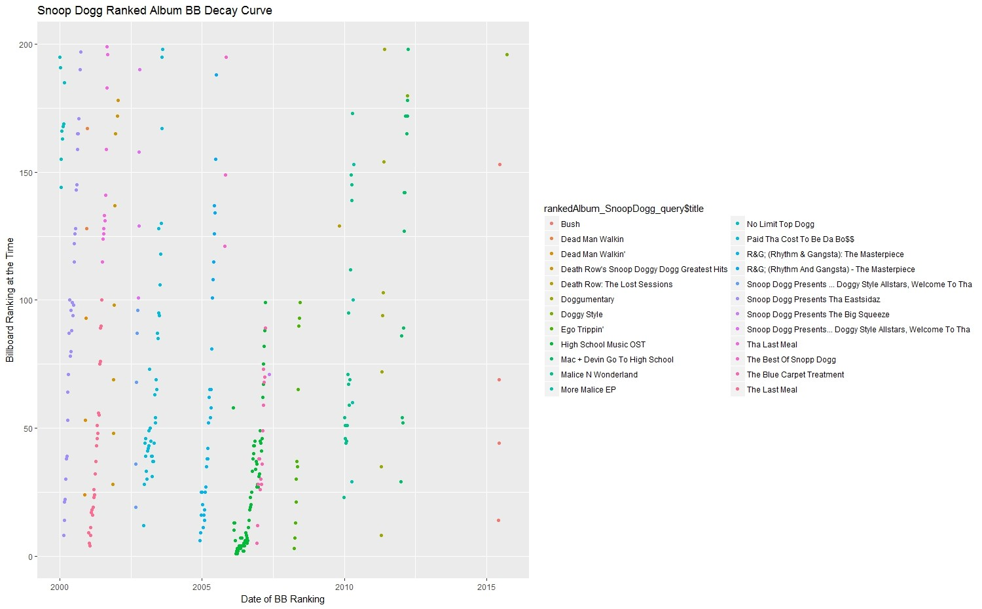
Exploratory Analysis on Genre: Hip Hop/Rap

Slide 11
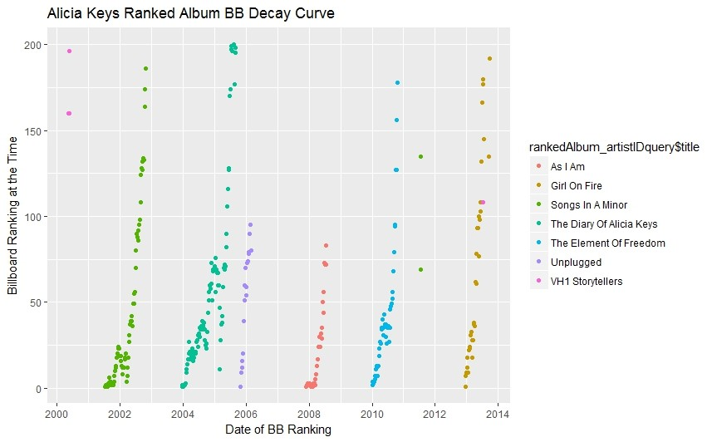
R & B

Slide 12
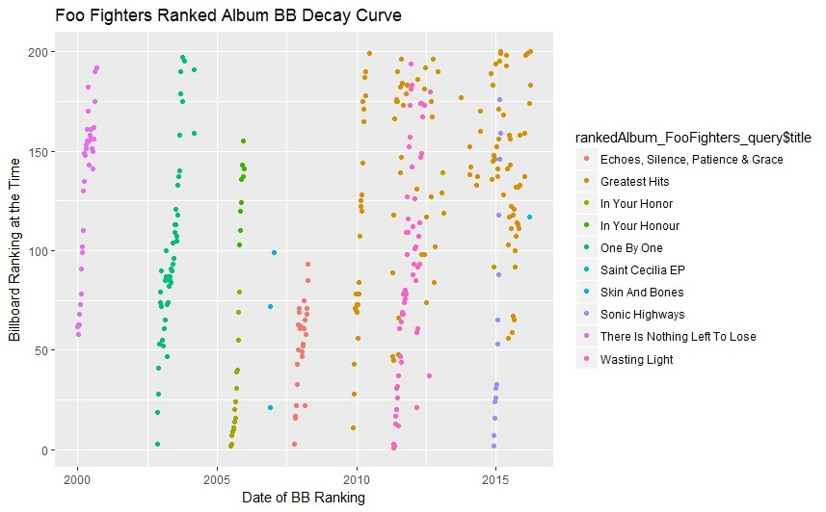
ROCK

Slide 13
Genre Features: Explanations
# of Albums
Number of albums in that genre before release data of album in question
# of Ranked Albums
Number of ranked albums in that genre before release date of album in question QUESTION - How do we take into account the ranks? E.g. 3 albums ranked as 10, 20, 30 VERSUS 3 albums ranked as 1,2,3
Avg.-Ranked Albums
Average of rank of ranked albums in that genre before release date of album in question QUESTION – How do we take into account the distribution of ranks? E.g. 3 albums ranked as 20, 30, 31 vs 20, 30, 60
Std. dev of Albums
Standard deviation of rank of ranked albums in that genre before release date of album in question

Slide 14
Lets say, Rap became popular recently or Rock is not that popular now
Past
Past 3 years
Past 1 year
Genre Feature
Past 5 years

Slide 15
Label Features: Explanations
# of Albums
Number of albums by the same label before release data of current album
# of Ranked Albums
Number of ranked albums by the same label before release date of album in question
Avg.-Ranked Albums
Average of rank of ranked albums by the same label before release date of current album
QUESTION - How do we take into account the ranks? E.g. 3 albums ranked as 10, 20, 30 VERSUS 3 albums ranked as 1,2,3
Std. dev of Albums
QUESTION – How do we take into account the distribution of ranks? E.g. 3 albums ranked as 20, 30, 31 vs 20, 30, 60
Standard deviation of rank of ranked albums by the same label before release date of current albums

Slide 16
Lets say, T Series became popular recently or Universal is not that popular now
Past
Past 3 Years
Past 1 year
Label Feature
Past 5 years

Slide 17
Feature Matrix
Star Power
Genre Features
Label Features
…………… …………… …………… …………… …………… …………… …………… …………… ……………
Albums
…………… …………… …………… …………… …………… …………… …………… …………… ……………
…………… …………… …………… …………… …………… …………… …………… …………… ……………

Slide 18
Ranked vs Not

Slide 19
Machine Learning
Support Vector machines
Random Forest
Logistic regression

Slide 20
Support Vector Machines
Non-linear RBF Kernel
10 fold cross validation
Grid search: Cost: 10e-6 to 10e4
Grid search: Gamma:10e-7 to 10e+3
6 C and 6 gamma values = 36 combinations across 10 fold cross val
36 c and gamma combinations
Parameter | Precision | Recall | F measure
C= 10, gamma =1 | 73% | 31% | 45%
C = 1, gamma = 1000 | 70% | 40% | 50%

Slide 21
Random Forest
Parameter- “mtry” : Number of variables sampled at each split. 2 to 19
10 fold cross validation
Best Mtry | Precision | Recall | F measure | AUC
Mtry = 5 | 63% | 84% | 73% | 73%

Slide 22
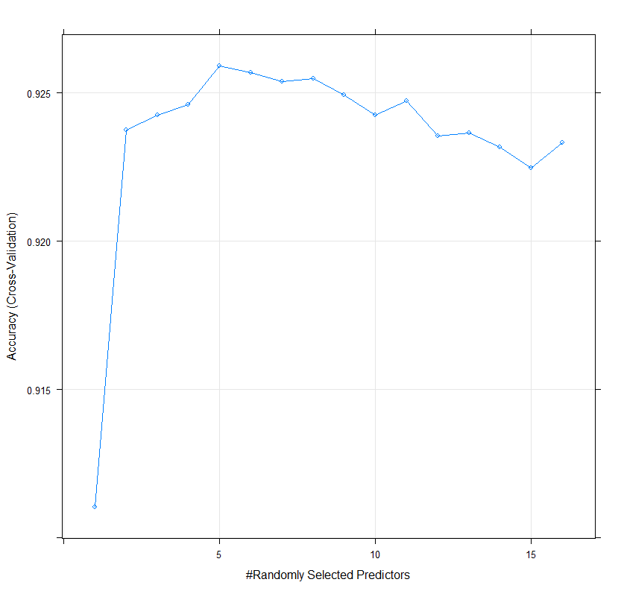
Random Forest
Best accuracy at mtry = 5

Slide 23
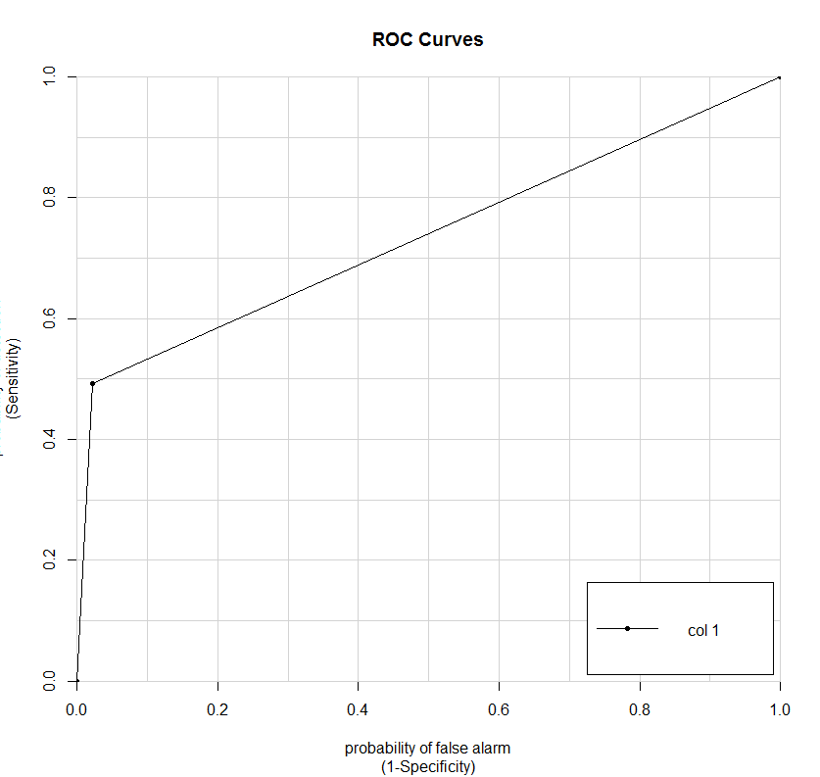
Random Forest: AUC = 73%
73%

Slide 24
Assumptions
Only solo artists considered.
Music albums only after 2000 taken into account.

Slide 25
Challenges
Feature Engineering – Coming up with true statistic measures to represent power of things like genre, label.
Data was stored on SQL cloud, so feature creation was a big task as data was remote and calculations took time even though computed on servers.

Slide 26
Next Steps
On going project
Create Network Features
Try more algorithms like logistic regression
Try more algorithms and tuning parameters

Slide 27
THANK YOU! Questions?

